Slide 1
ADVANCED
PHYSICS LABORATORY

Slide 2
ORGANIZATION
The advanced physics laboratory formally lasts two semesters: the first module (A) begins in the spring, the second one (B) in the fall.
The approach of the course is very “hands on”. Each group is actively involved in all the main phases of a real experiment: design of the experiment, realization of (parts) of the setup, assembly and calibration of the apparatus, data taking and analysis, writing of the final report.
→Each group then works on only one experiment during the two semesters.

Slide 3
LECTURES
Each semester, before the beginning of the experimental activity in the lab, i.e. the first four weeks, there are lectures on basic, fundamental methodologies and instrumentation
Topics involve signal processing and lockin amplifiers, feedback circuits, temperature control and thermometers, vacuum techniques and pumps, light beams and lasers, interferometry and detectors…
Lectures notes are provided in Moodle page

Slide 4
EXPERIMENTS
The available experiments cover the main research areas of the Master in Physics program: physics of matter, light and waves, particle physics, nuclear physics
Each experiment is followed by one group
Each group should be formed by 2 or 3 students
The group must be formed by 3 students, if one plans to go in Erasmus in the fall semester
Try to form the groups asap
If there are not enough experiments in one area, please let me know

Slide 5
EVALUATION
The overall evaluation will take into account the lab work, the written report and the final oral exam
The oral exam will address the experimental activity, the written report and material presented in the frontal lectures
The final oral exam should be taken by the whole group, although the grade is individual
If a student follows only the first semester, at the end there is the exam for the part A
If a group follows the two parts A and B, it may choose to take only one exam at the end of the fall semester

Slide 6
EXPERIMENTS
OF
PHYSICS OF MATTER
giampaolo.mistura@unipd.it

Slide 7
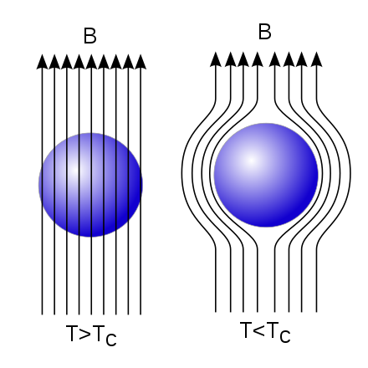
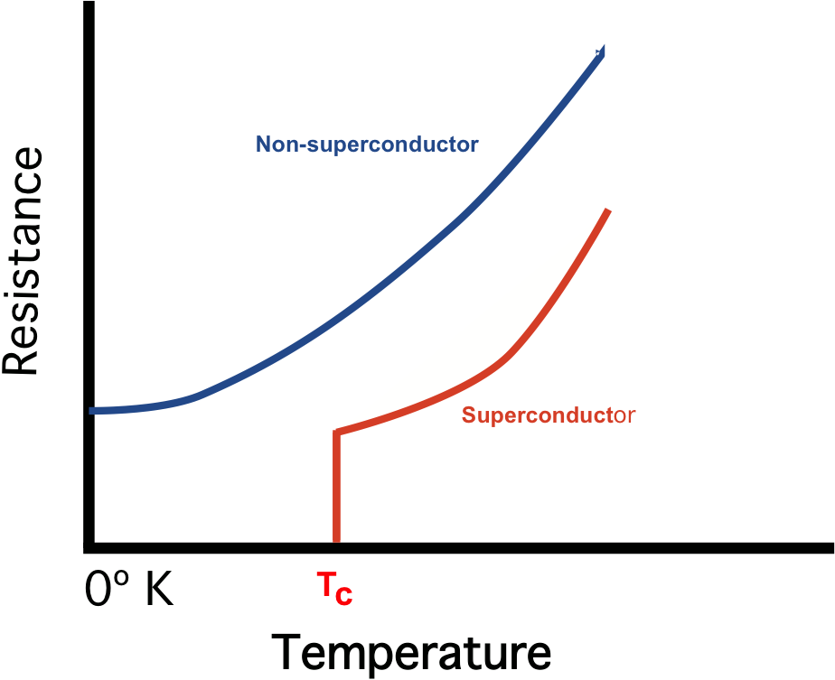
Superconductivity projects Below a critical temperature Tc, superconductors enters a novel quantum state and offer no resistance to the passage of electrical current
Detection Tc via resistance measurement
Detection Tc via Meissner effect
GOAL: build a setup to cool down and detect the superconducting transition
ACTIVITIES: Design and build electronic circuits; assemble setup; acquire data; analyze data
MAIN CONTENTS: Electronics, Vacuum chamber, Cryostat
GOAL: build a setup to cool down and detect the superconducting transition
ACTIVITIES: Design and build electronic circuits; assemble setup; acquire data; analyze data
MAIN CONTENTS: Electronics, Vacuum chamber, Cryostat

Slide 8
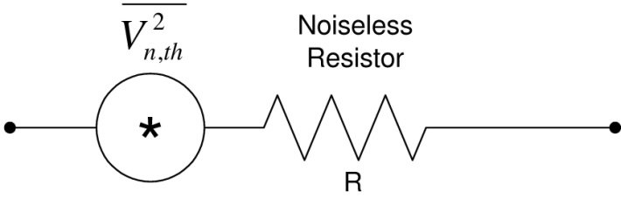
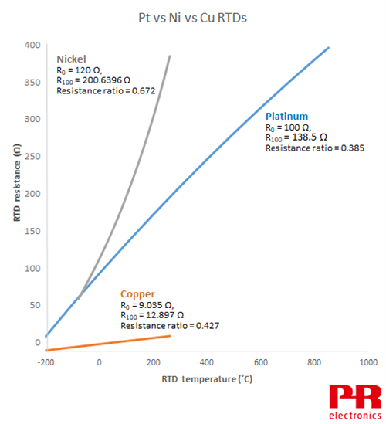
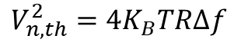
Solid state projects Metallic conductors exhibit characteristic transport properties dependent on temperature
Measurement thermal noise resistor
Measurement resistance vs temperature of a metal
$$V_{n,th}^{2}=4K_{B}TR∆f$$
GOAL: build a setup to cool down and measure the thermal noise across a resistor
ACTIVITIES: Design, build and test amplifier circuits; assemble setup; acquire data; analyze data
MAIN CONTENTS: Electronics, Vacuum chamber, Cryostat
GOAL: build a setup to cool down and measure the temperature dependance of a metal
ACTIVITIES: Design, build and test electronic circuits; assemble setup; acquire data; analyze data
MAIN CONTENTS: Electronics, Vacuum chamber, Cryostat

Slide 9
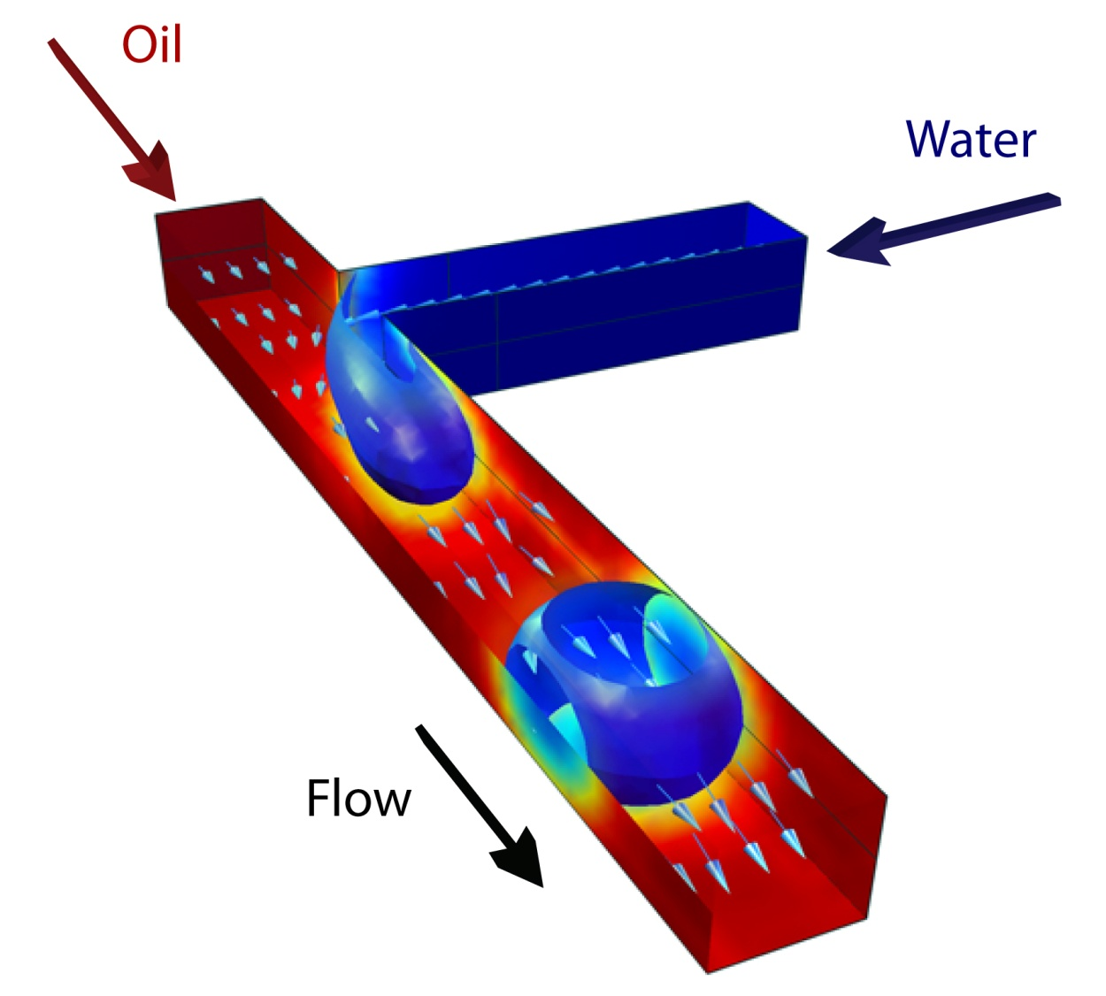
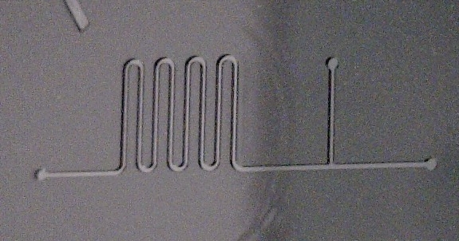
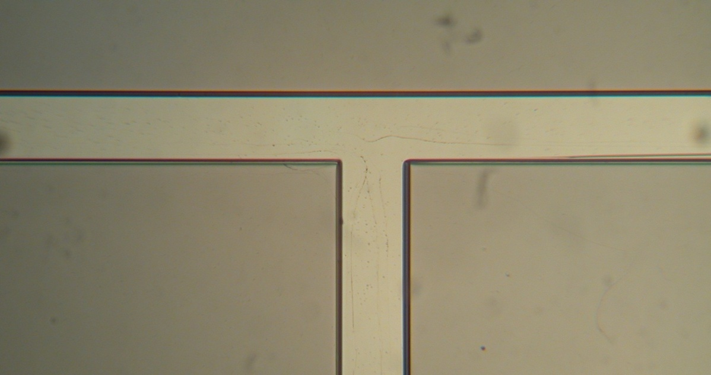
Soft matter projects Microfluidics is an emerging technology to control micrometric amount of liquids for applications in soft matter, biochemistry, medicine…
Characterization microfluidic T-junction
Measurement droplet speed in a microchannel
GOAL: build a setup to generate droplets of known volume
ACTIVITIES: Design, build and test opto detectors; fabricate T-junction; assemble setup; acquire data; analyze data
MAIN CONTENTS: Electronics, Optical detectors, 3D printing, Flow pumps
GOAL: build a setup to activate droplets of known volume
ACTIVITIES: Design, build and test opto detectors; fabricate holders; assemble setup; acquire data; analyze data
MAIN CONTENTS: Electronics, Optical detectors, 3D printing, Flow pumps

Slide 10
EXPERIMENTS
OF
OPTICAL PHYSICS
marco.bazzan@unipd.it

Slide 11
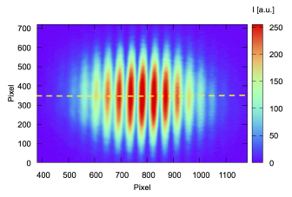
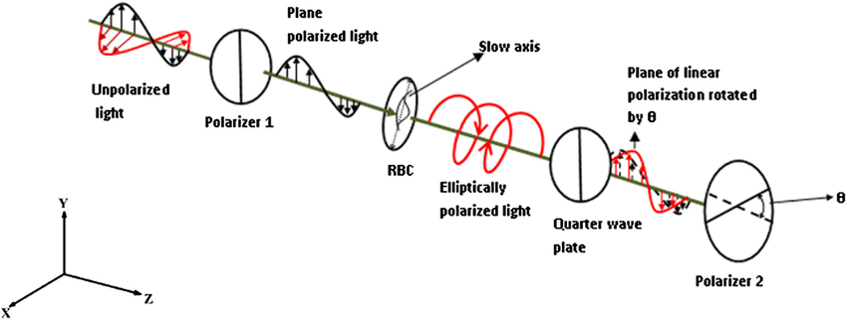
Optics projects (1)
Polarimetric measurement of Pockels effect
Interferometric measurement of the electro-optic effect
GOAL: build a setup to study externally induced birefringence by the polarimetric Sénarmont method.
ACTIVITIES: Build the setup and amplification electronics; perform measurement of the induced birefringence
MAIN CONTENTS: Electronics, Polarization optics, Lasers
GOAL: build an interferometer with pm –level sensitivity and use it to characterize the refractive index change induced by an electric field (electro-optic effect).
ACTIVITIES: build and align the interferometer, build the control electronics and the signal detection systems, perform the measurements.
MAIN CONTENTS: Optics, Lasers, Electronics

Slide 12
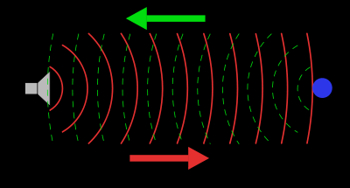
Optics projects (2)
Ultrasound interference
Ghost Imaging
GOAL: build, characterize and operate a scattering experiment to study the wave-like nature of ultrasound
ACTIVITIES: Build source, detector and amplification electronics; perform measurement of sound waves amplitude as a function of the scattering angle
MAIN CONTENTS: Electronics
GOAL: reconstruct an image from the correlations of two random optical fields
ACTIVITIES: build and align the setup, perform the measurements and analyze the data.
MAIN CONTENTS: Optics, data analysis

Slide 13
EXPERIMENTS
IN
NUCLEAR PHYSICS

Slide 14
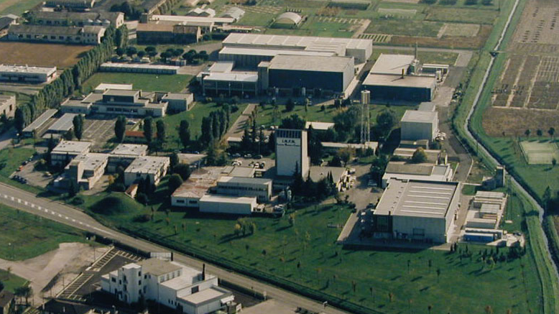
Experimental activity will be done at the Laboratori Nazionali di Legnaro
Istituto Nazionale di Fisica Nucleare

Slide 15
Measurement of Heavy-Ion Fusion Cross Section
(study of the quantum tunneling effect in complex systems)
montagnoli@pd.infn.it, stefanini@lnl.infn.it

Slide 17
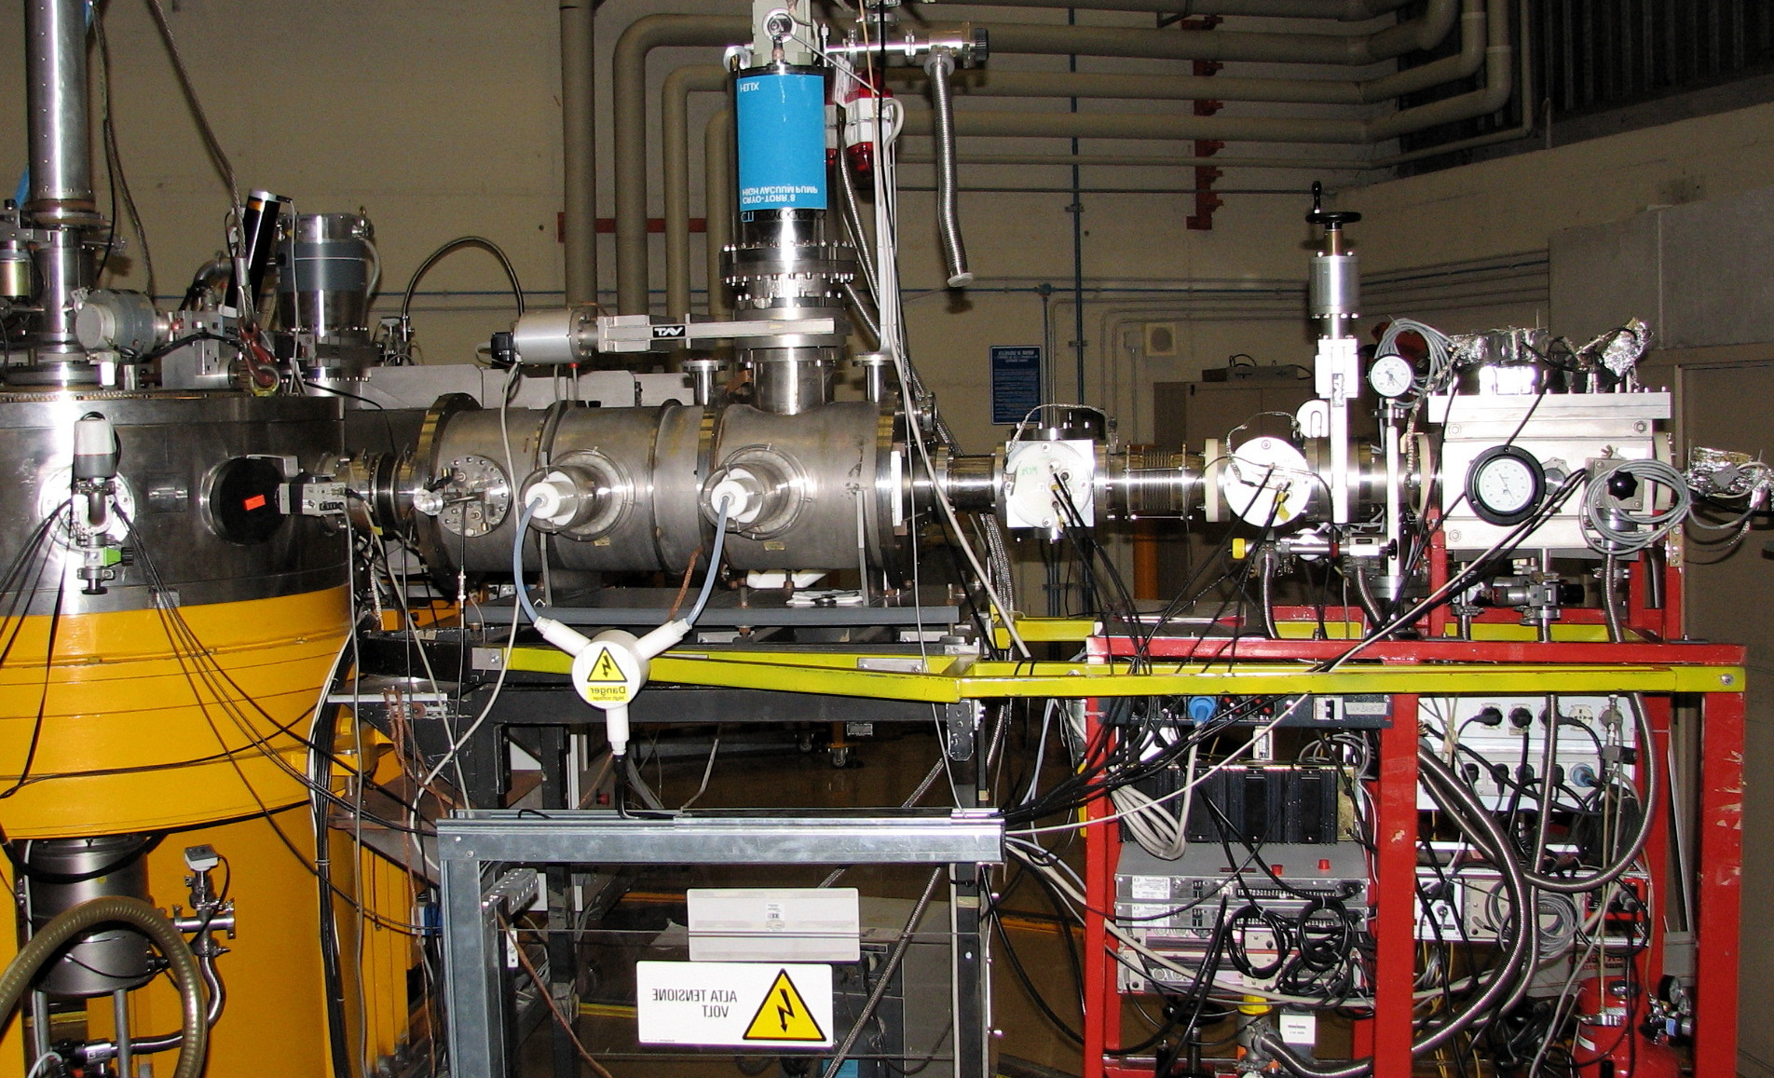
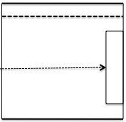
Electrostatic separator and E-ΔE-ToF telescope to detect
evaporation residues at ≈ Oº, installed at INFN - Legnaro
scattering chamber
MCP, IC & Si detectors
beam
E-ΔE-ToF telescope
detecting ER
HV
_
_
target
+
+
HV

Slide 18
Activities
- acquiring current experimental techniques of nuclear physics
detectors for particles and heavy ions, electronics for signal processing, data acquisition, and analysis
performing a measurement using the set-up based on the electrostatic deflector of the LNL; in particular, the effective solid angle of the device will have to be determined and the performance of its detectors shall be characterized.
Requested commitment
One afternoon per week (about 3h) each semester during the preparation of the set-up and for the data analysis
2-3 consecutive days during the experiment (data taking)

Slide 19
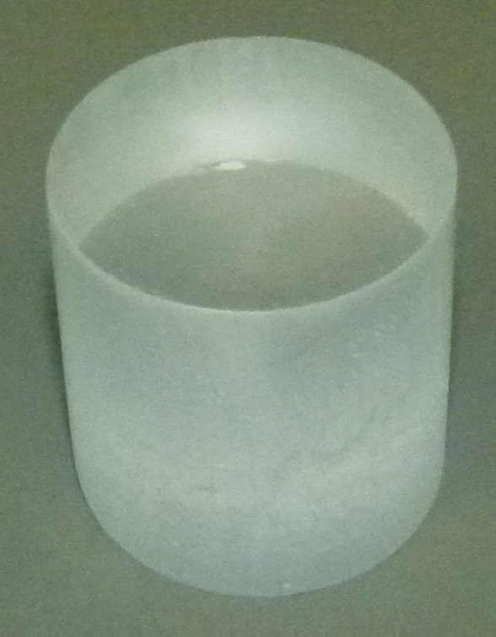
Neutron measurement CLYC scintillators
javier.valiente@lnl.infn.it
Characterization of CLYC scintillators for the detection of:
Gamma rays
Neutron sources
The electronic chain mounting and some data analysis is foreseen.
CLYC detector
Gamma Spectroscopy: Energy of the photon from photeletric effect (4% resolution at 662 keV)
Neutron Spectroscopy: Energy from time-of-flight
Energy directly from nuclear reactions on 35Cl inside the scintillator.
CLYC scintillator is suitable to perform all the three kinds of measurements
Gammas

Slide 20
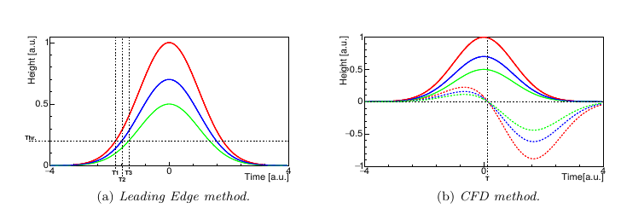
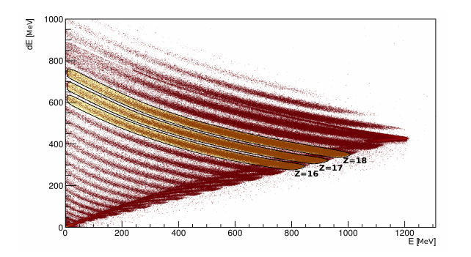
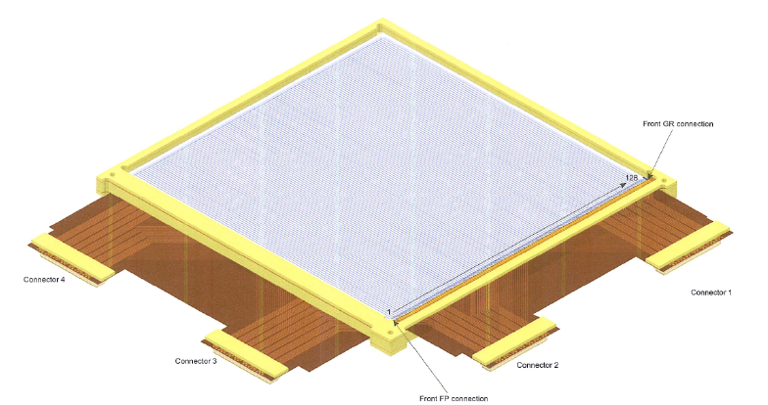
Measurement of charged particles via silicon detectors
javier.valiente@lnl.infn.it
Signal processing
Characterization of novel detectors for particle spectroscopy:
Energy
Time
Signal treatment: neural networks
The electronic chain mounting and some data analysis is foreseen.
Ion identification
Silicon detector

Slide 21
EXPERIMENTS
IN
PARTICLE PHYSICS

Slide 22
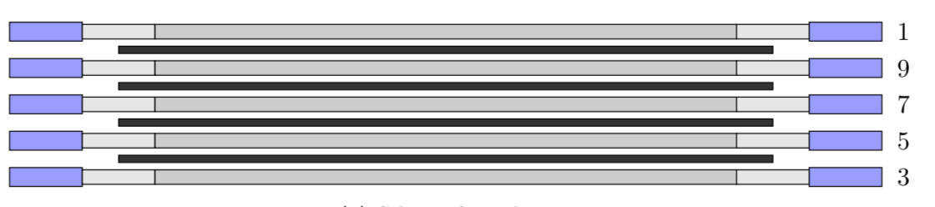
Cosmic muons detection: measurement of their lifetime
alberto.guglielmi@pd.infn.it, christian.farnese@pd.infn.it
The experiment is devoted to the measurement of cosmic muon lifetime τ of μ coming at rest in Aluminum using experimental techniques employed in high energy & astro-particle physic experiments.
The set-up is composed by large Al slabs alternating to plastic scintillation slabs read-out by 2 photomultipliers at their extremities. The muon lifetime is measured on the basis of the time interval between the muon entrance in the apparatus and the subsequent delayed emission of the electron produced in the muon decay.
The experiment allow to measure lifetime of both μ⁺ and μ⁻ separately according to the different interaction channels (μ⁻ can be adsorbed in Al nuclei): τ(μ+) ~ 2.2 μs, τ(μ-) ~ 0.88 μs
μ
e
ν_{e}
ν_{μ}

Slide 23
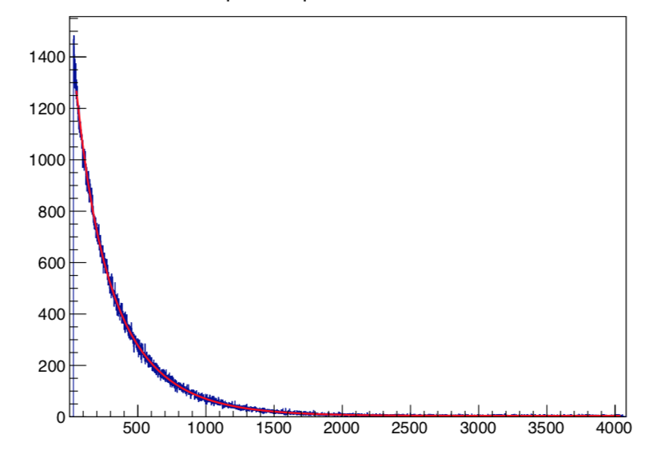
Two steps experiment/Lab Modules
The first step consists in the characterization/optimization of the setup followed by an initial data taking:
Cosmic ray detection efficiency of the photomultipliers connected to the plastic scintillators as a function of the applied H.V., the discrimination threshold.
Calibration of the Time to Amplitude Converter (TAC) and of Analog to Digital Converter (ADC) used in the data acquisition
Then logic circuits identifying μ entrance in the apparatus and the electron/positron produced in the m decay are prepared. A first μ lifetime evaluation is performed with a week data taking.
In the second part of the experiment (next Laboratory module), lifetime of μ⁺ and μ⁻ and ratio R of their flux are determined from the analysis of the collected temporal spectrum. The required algorithms are prepared and tuned on simulated muon decay spectra prepared by dedicated simple MC.
τ(μ-) ~ 0.88 μs
counts
τ(μ+) ~ 2.2 μs
TAC channel (5 ns)

Slide 24
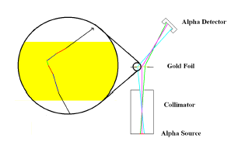
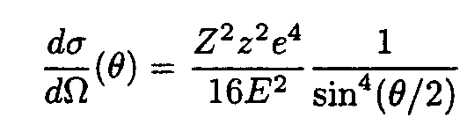
Rutherford Scattering experiment
G.Collazuol, G.Simi
Objectives
1) Experimental introduction to scattering and interaction of
alpha particles with matter
2) setup designed and built (at least in part) by students
(from mechanics to electronics)
3 Phases
1) setup design (~10h)
2) setup construction (~25h)
3) calibrations and measurements (~35h)
Measurement of the
Rutherford scatteriong
cross section
+ effetti screening, ...
Notes:
...for a more extensive review → GC at IDPASC 2013 (Siena)

Slide 25
Experiment in 3 phases
Setup Design
Based on preliminary estimate and toy simulation
→ setup geometry
→ choice of the detectors
1) Mechanics:
- vacuum vessel
- collimators, holders → 3D printed by students
- targets (Al, Ni, Cu, Mo, Pd, Pt, Ta, Au), made at LNL laboratories
2) Detectors
- Silicon detectors or
- scintillators readout by Silicon Photomultipliers
3) Front-end and Readout electronics
- Front-end amplifiers can be designed and built by students
- Readout digital electronics can be wither FPGA (to be programmed by students firmware)
or wavefor digitizer (to be programmed, software)
Setup construction
Calibrations, Measurements, Analysis
1) Calibration of detectors and electronics (in air and in vacuum)
2) Alpha particle spectroscopy (²⁴¹Am source ) → range, straggling e Bragg curve
3) Final setup measurements:
- beam and source characterization
- energy losses characterization and not active layers investigation
- differential cross-section measurements
- comparison with simulation and analysis of systematics
Notes:
...for a more extensive review → GC at IDPASC 2013 (Siena)

Slide 26
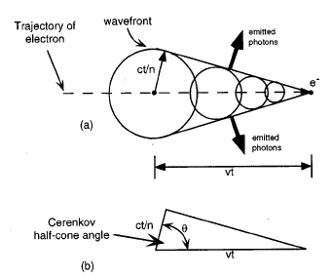
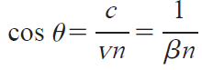
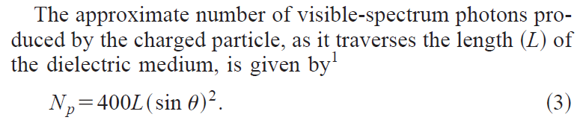
Cherenkov light experiment
G.Collazuol, G.Simi
Objectives
1) The experiment aims at investigating the angle of Cerenkov
light emitted by 2-MeV electrons traversing an acrylic detector.
2) setup designed and built (at least in part) by students
(from mechanics to electronics)
3 Phases
1) setup design (~10h)
2) setup construction (~25h)
3) calibrations and measurements (~35h)
Notes:
...for a more extensive review → GC at IDPASC 2013 (Siena)

Slide 27
Experiment in 3 phases
Setup Design
Based on preliminary estimate and toy simulation
→ setup geometry
→ choice of the detectors
Setup construction
1) Mechanics and Beam
- source collimation a
- electron momentum selection and focusing via permanent magnets
2) Detectors
- scintilaltori/acrylic/glass
- Photomultipliers or Silicon PM
3) Front-end electronics and readout
- simple analog electronics to be designed and built
- digital electronics for trigger and acquisition to be programmed (FPGA)
Calibrations and Measurements
1) Detectors and Electronics calibration
2) Electron beam characterization (with ancillary position sensitive silicon or gas detectors)
3) Final setup measurements and systematics evaluation
Notes:
...for a more extensive review → GC at IDPASC 2013 (Siena)

Slide 28
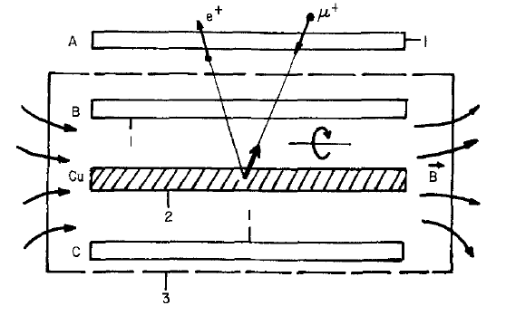
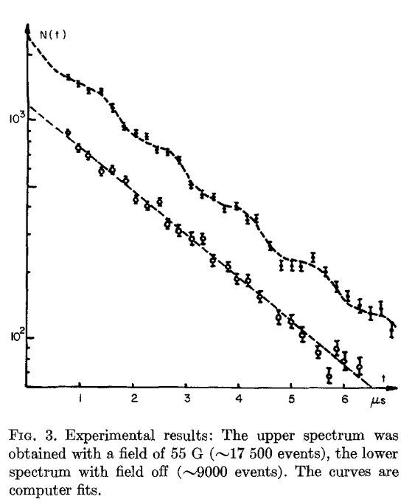
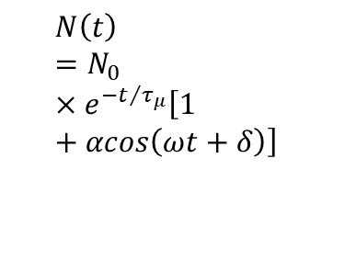
Measurement of the muon g-2 (G. Simi, G. Collazuol)
Goal
measure the muon g-2 which is a sensitive test of the Standard Model. Precise experiments (at CERN and Fermilab) could provide evidence for new physics.
Procedure
Stop the cosmic ray muons in an absorber inside a magnetic field
Detect the muon decay into electron(+neutrino) with scintillators readout by SiPM
Record the decay time in the upper hemisphere and model it with an asymmetric decay
The factor ω is the spin precession frequency proportional to g-2
Student Activities
Construction of the experimental setup from scratch similar to a real experiment: simulation, scintillators assembly, analog electronics construction and calibration, digital acquisition setup, data analysis with ROOT
Results
Muon g-2, muon lifetime, test of special relativity, evidence for parity violation in the decay of the muon (and the pions)
Scintillator
SiPM
Solenoid
Absorber
muon
PC
(analisi)
ARIETTA
(tempo)
FPGA
(logica)
Decay Time Distribution
$$N\left(t\right)=N_{0}×e^{{−t}/{τ_{μ}}}\left[1+αcos\left(ωt+δ\right)\right]$$

